Slide 1
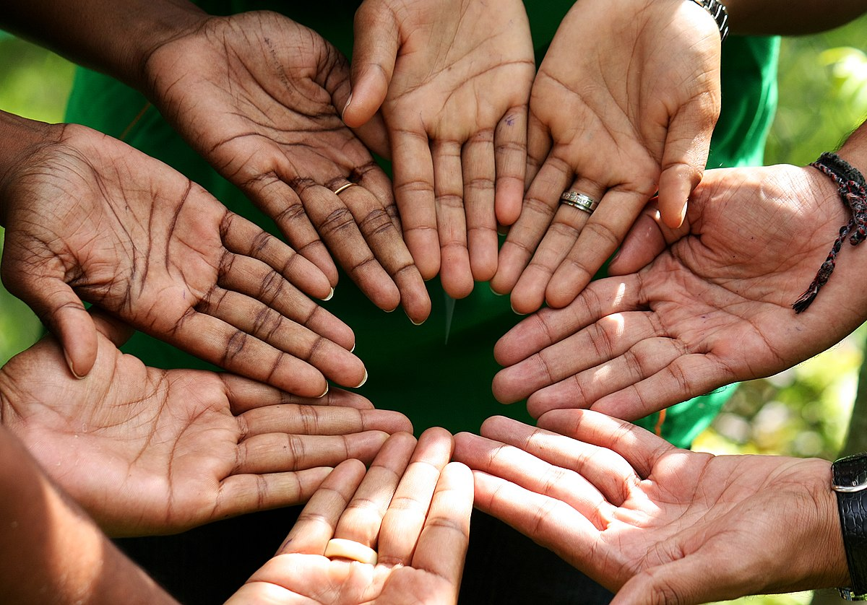
Hand in Hand
Presented by:
Suman Rijal
Prashant Phuyal
Janak Bajagain
Alina karki

Slide 2

What is Hand in Hand?
An application for emergency.
Whenever blood required it provide information of blood donor.
Whatever emergency occurs it provide information of near hospital, police, fire bricked and ambulance.
Related to community.

Slide 3
Why Hand in Hand?
For emergency situation to community
Related with government, NGOs.
Easy , reliable and fast service.
Authorized user

Slide 4
How it works?

